Slide 1

Commerce City Garbage & Recycling Program Overview
2015 Implementation
Maria D’Andrea, P.E.
Director of Public Works

Slide 2


Commerce City Is Thinking Green!
In 2015, Commerce City rolled out new residential trash and recycling collection services, switching to a fully automated cart collection system.
This change reduces environmental impacts, saves the City money and makes collection more efficient for everyone.
Waste Management worked closely with Commerce City to ensure a smooth transition.

Slide 3
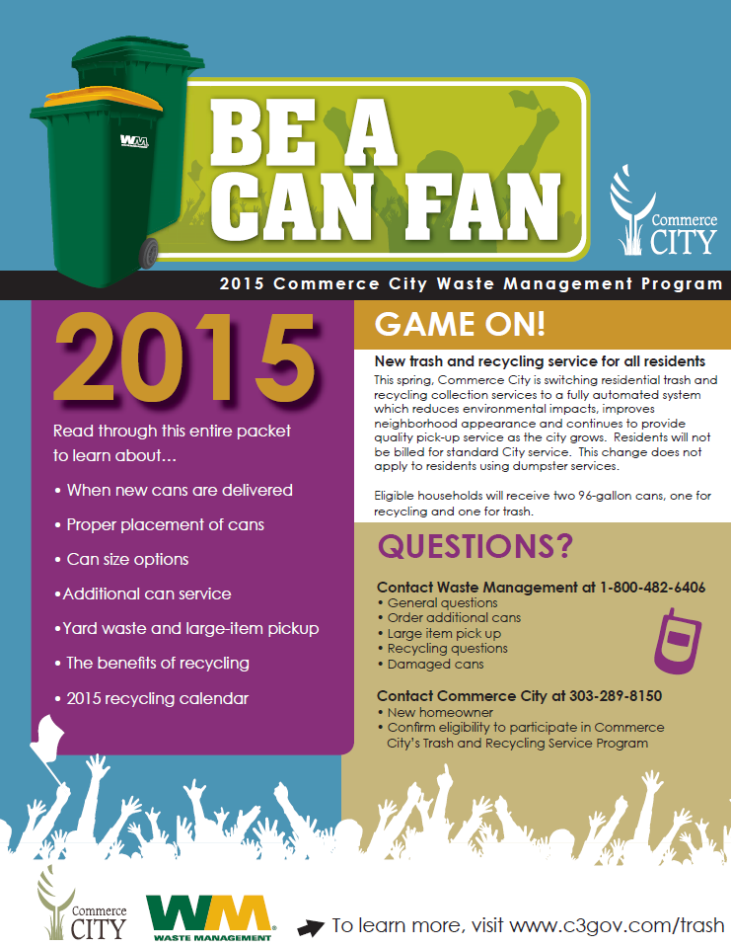
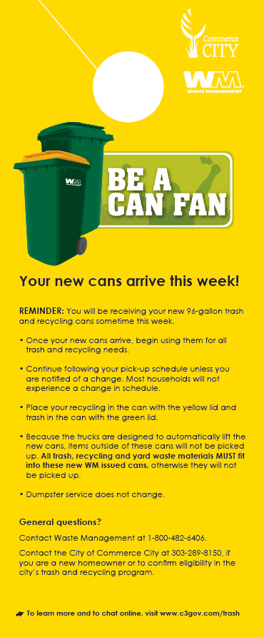
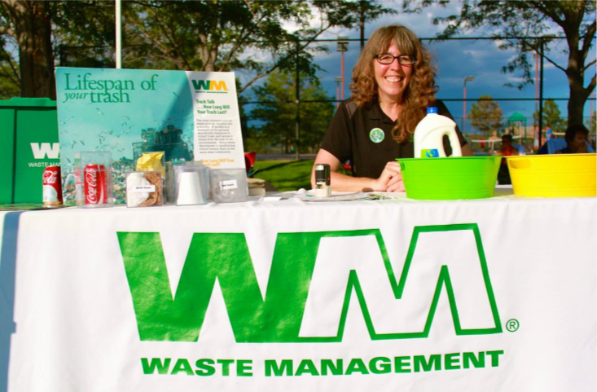
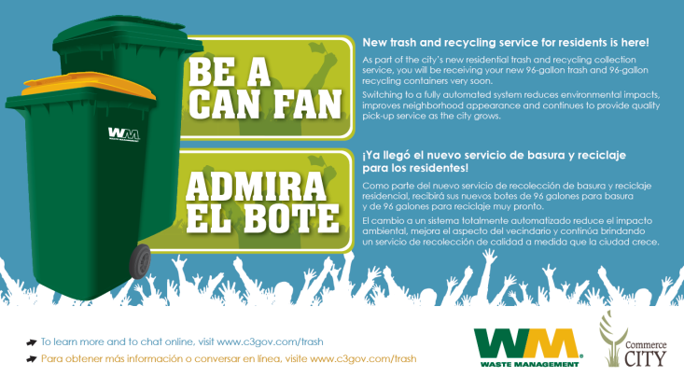
Outreach Activities Raised Awareness, Sparked Action

Slide 4
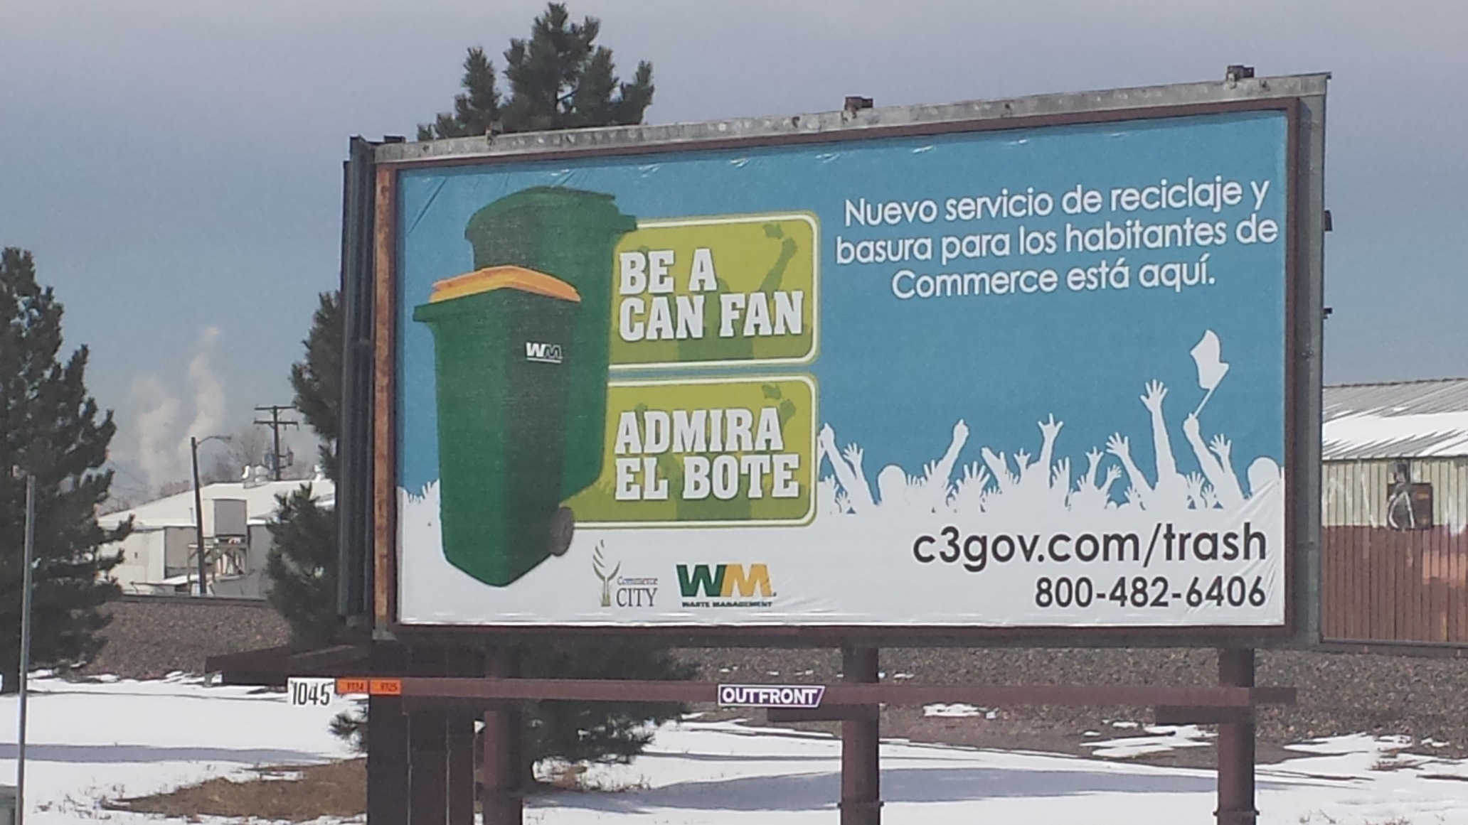

Slide 5
Participation Increased Significantly
Implementing carts and a strong outreach plan led to higher diversion rates in 2015.

Slide 6
EXERCISE - Calculate the Diversion Rate
2012:
18,096 Tons of Garbage and 1,511 Tons of Recycling
1,511 / (18,096 + 1,511) = ????
1,511 / (18,096 + 1,511) = 7.7%
2015:
18,102 Tons of Garbage and 2,835 Tons of Recycling
2,835 / (18,102 + 2,835) = ????
13.5%

Slide 7
Residents Recycled a Range of Materials
Commerce City residents recycled 2,835 tons of aluminum, cardboard, paper, scrap metals, glass and plastics #1-#7 in 2015.

Slide 8
Paper, Cardboard Dominated the Mix

Slide 9
Volume Peaked in Summer Months

Slide 10
Tonnage of Recycling: Volume to Weight Conversion
Based on US Environmental Protection Agency (EPA) & RecycleMania competition:
Flattened corrugated cardboard weighs: 100 pounds/cubic yard
How much cardboard, by weight, can fit in a 96-gallon can?
1 gallon = 0.00576 cubic yards
96 gallons = ???? cubic yards
96 gallons = 0.552 cubic yards
100 pounds/cubic yard x 0.552 cubic yards = ????
100 pounds/cubic yard x 0.552 cubic yards = 55.29 pounds

Slide 11






Diverse Benefits for City, Residents
By recycling 2,835 tons, Commerce City conserved the following resources:
10,442,980 kWh of electricity
Enough to power 870 homes for a year
194,300 gallons of oil
Enough to heat and cool 962 homes for a year
44,838 gallons of gasoline
Enough to drive 1,255,474 miles
37,705 mature trees
Enough to produce 467,164,668 sheets of newspaper
13,077,852 gallons of water
Enough to meet the fresh water needs of 697,485 people for a year
9,588 cubic yards of landfill airspace
Enough to meet the disposal needs of 147,754 people

Slide 12
Shrinking Carbon Footprint
7,581 tons of residential recycled material diverted since 2012
Over 16,890 metric tons of CO₂ equivalent conserved
As calculated by the US EPA WARM Model

Slide 13
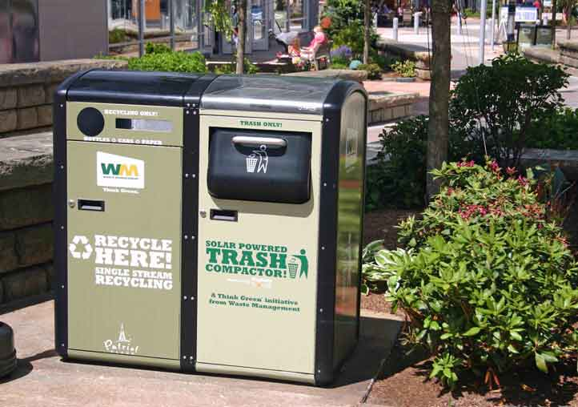
Solar Compactors Support Recycling Efforts
In 2015, Commerce City introduced two Big Belly Solar compactors in two widely used public spaces. One unit is located at 5902 Holly St. at Pioneer Park; the other is located at 6060 Parkway Drive at the Commerce City Recreation Center.
Commerce City uses dual units for trash and recycling. These units reduce the cost of collection with super solar compaction power.
The solar compactors are pictured with artwork created by a Commerce City youth that is attached to the front and back of each unit. A Big Belly onsite display took place on July 21, 2015 at City Park.

Slide 14
Questions ????

