Slide 1
Waste Reduction and Energy Conservation

Slide 2
WHO IS PROJECT ANGEL HEART?
A nonprofit organization operating in Metro Denver and Colorado Springs, providing made-from-scratch, nutritious meals to Coloradans living with life-threatening illness.

Slide 3
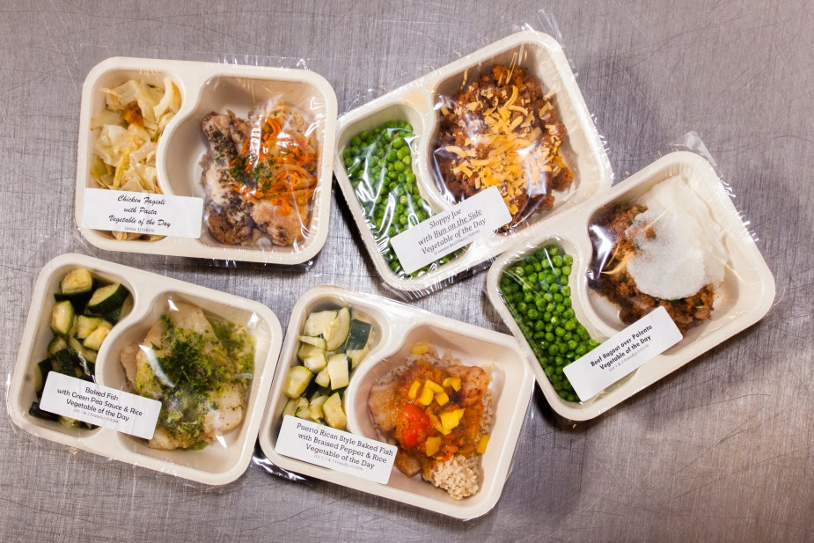
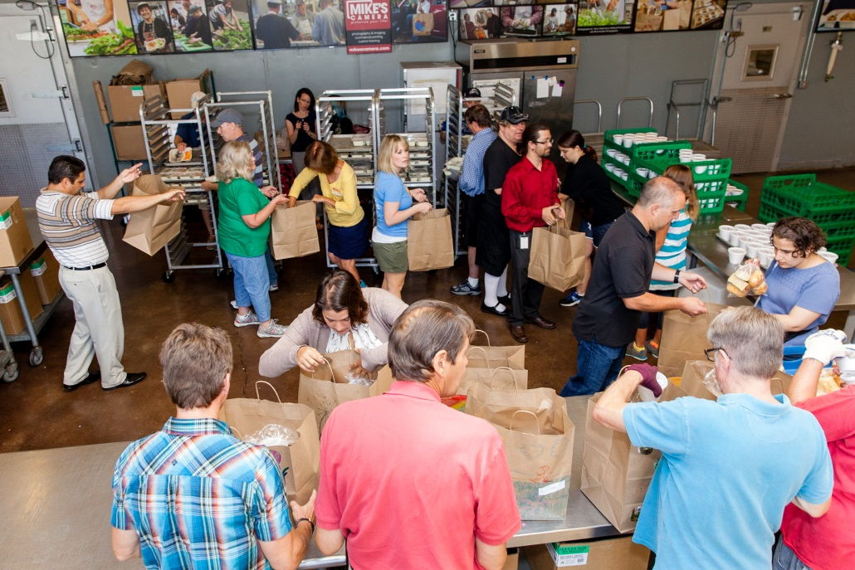
A look at what we do…
Volunteers
Home-delivered meals
Food as medicine

Slide 4
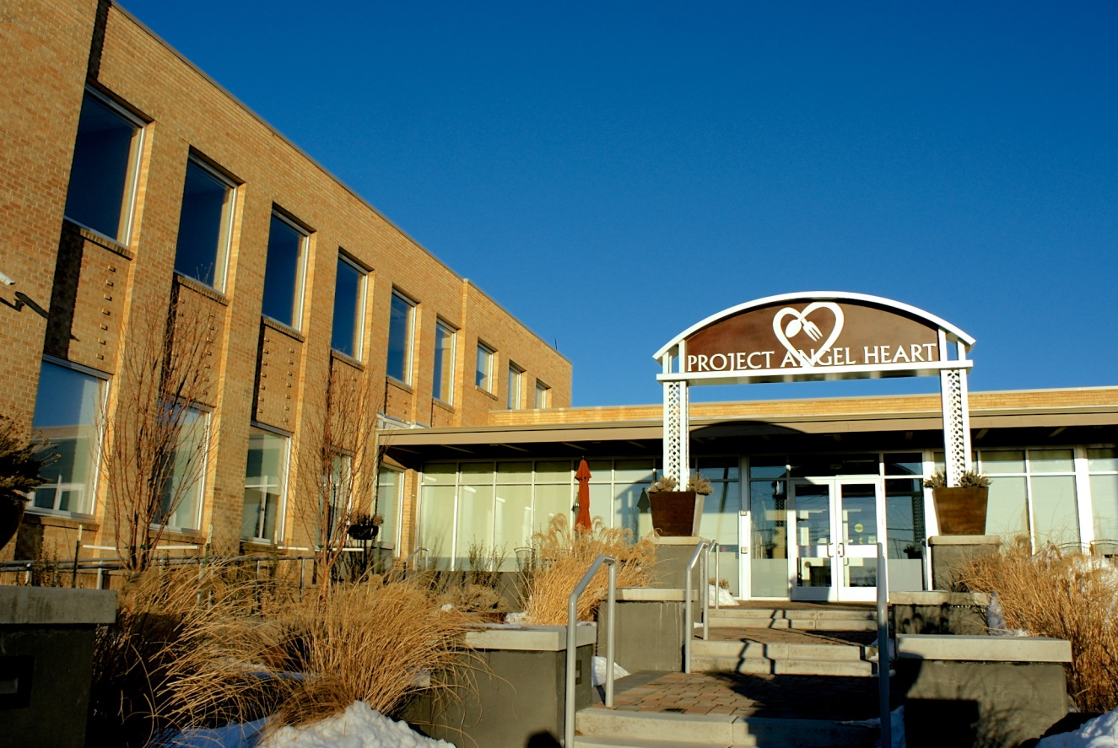
Waste Production
Commercial kitchen
Office space
Leased space
Delivered meals
Events

Slide 5
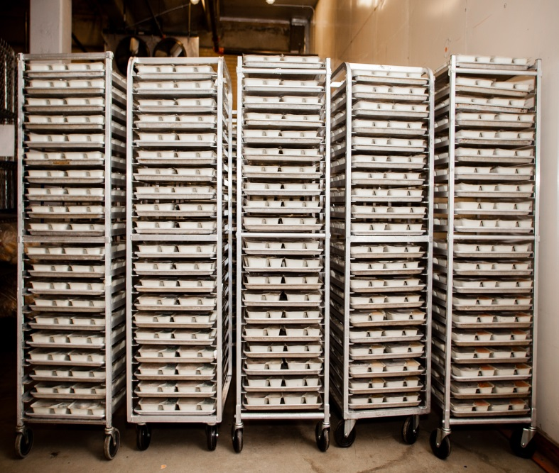
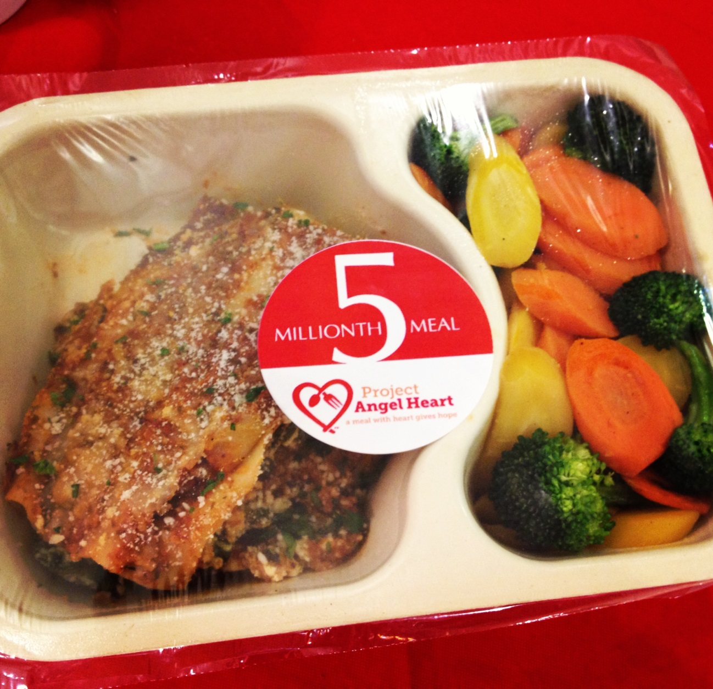
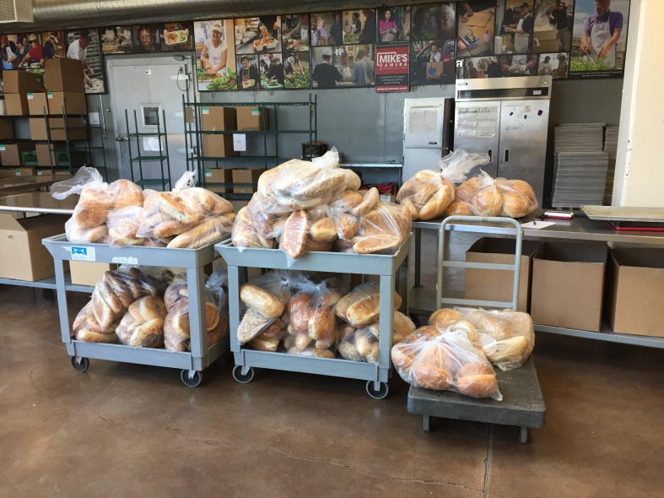
Meals

Slide 6
Our Waste Reduction Efforts
Partnership with Alpine Waste
Recycling & Composting
Composting and recycling stations throughout facility
Plastic bag recycling
Toner cartridge recycling
Half-used paper in printers

Slide 7
And more…
Installation of automatic hand dryer in restroom
Water cooler in break room
At events:
Water stations instead of bottles
Recycling and composting offered
Use of compostable plates, cups and silverware

Slide 8
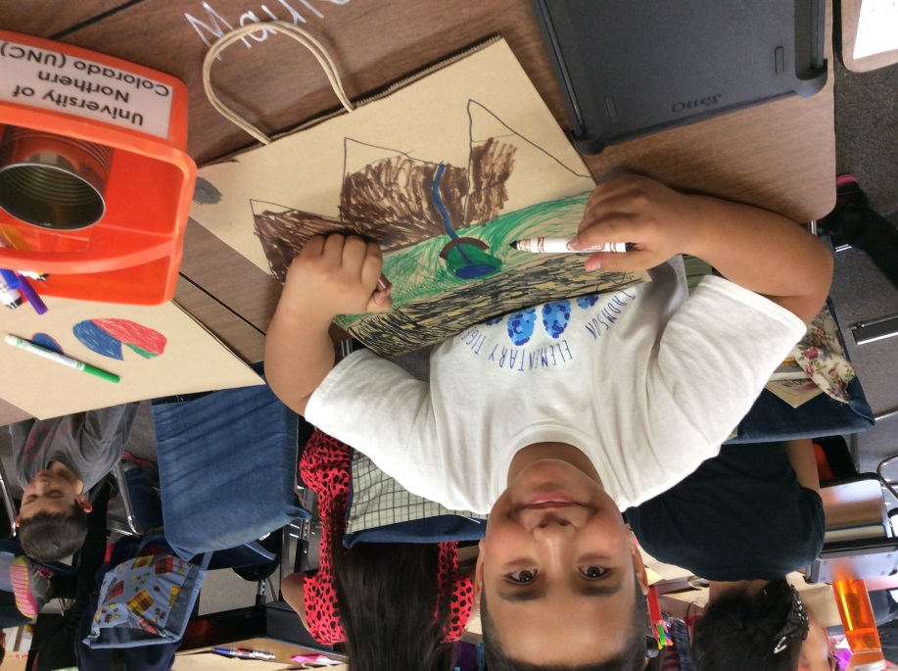
Meal Bags
Meal bag recycling program allowed us to reuse 56% of bags returned to the agency in 2014
Returned meal bags which are not reusable are recycled at our facility
Get involved!

Slide 9
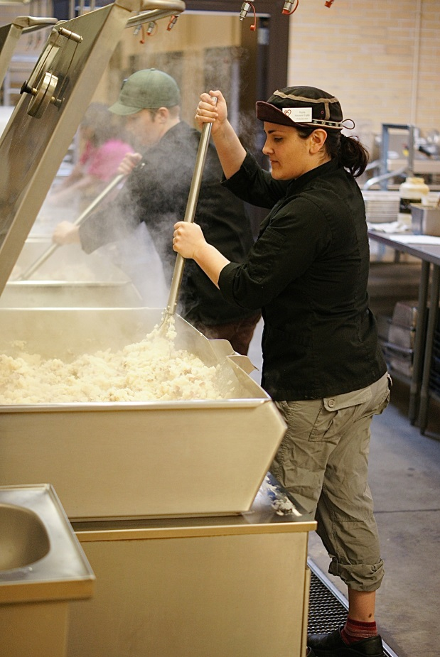
Donated Food
Reduction of food waste by accepting and using donated food – 22% in 2014
Hot dog bun soup!

Slide 10
Getting Results…
October diversion rate: 67%
As compared to 11% for the average Alpine customer
Ranked #267 out of 3,180 Alpine commercial customers

Slide 11
Environmental Impact
121 gallons of oil conserved
12 trees saved
3,927 gallons of water saved
Kept 1 truckload of trash out of the landfill

Slide 12
Ways for Other Business to Reduce Waste
Implement recycling and composting stations throughout facility
Reuse paper
Set-up a collection station for ‘hard to recycle’ items such as batteries and electronics
Use glasses and porcelain dishware instead of paper and/or plastic cups and plates

Slide 13
Collaboration/Participation
Work with each other and share ideas! Hold each other accountable and report any concerns
Get creative! Hand out ‘green’ awards to top contributing departments and staff members
Report on sustainability
Ask for help from waste management vendors – most of whom will provide weight totals for recycling, compost and landfill waste

Slide 14
Resources

Slide 15
Ideas in Energy/Resource Conservation
Meter monitoring device
NEEP participation
End-of-day checklist
Thermostat tip
Resource conservation via locally produced meats and veggies

Slide 16
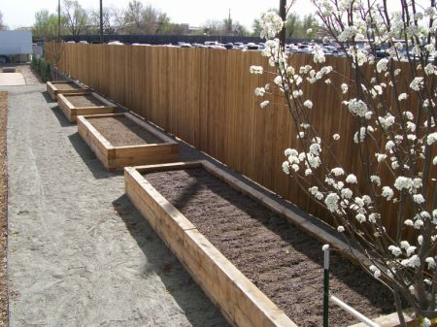
Energy & Resource conservation

Slide 17
Questions

